Slide 1
Course Review and Summary
Xiangyi Chen
xiangyichen@swjtu.edu.cn

Slide 2
Outline
1. OS overiew
  1.1 OS objects
  1.2 Evolution of OS
  1.3 Kernel Space vs User Space
  1.4 Features of Modern Operating Systems
2. Process and threads
  2.1 Process Descriptions
  2.2 Process Control Block
  2.3 Five-state transition and seven-state transition
  2.4 Process switching
  2.5 Threads
  2.6 Type of Threads
  2.7 Short-term scheduling
  2.8 Approach of thread scheduling

Slide 3
Outline (cont.)
3. Concurrency: mutual exclusion and synchronization
  3.1 Mutual Exclusion
  3.2 Semaphore
  3.3 Monitor
  3.4 Message passing
  3.5 Producer/Consumer Problem
  3.6 Reader Writer Problem
4. Concurrency: Deadlock and starvation
  4.1 Conditions for Deadlock
  4.2 Three approaches dealing with deadlock
  4.3 Dining Philosophers Problem

Slide 4
Outline
1. OS overiew
  1.1 OS objects
  1.2 Evolution of OS
  1.3 Kernel Space vs User Space
  1.4 Features of Modern Operating Systems

Slide 5
1.1 OS Objectives
A program that controls the execution of application programs
An interface between applications and hardware
As the resource manager the usage of resource in computer
Convenience
Efficiency
Ability to evolve
Main objectives of an OS

Slide 6
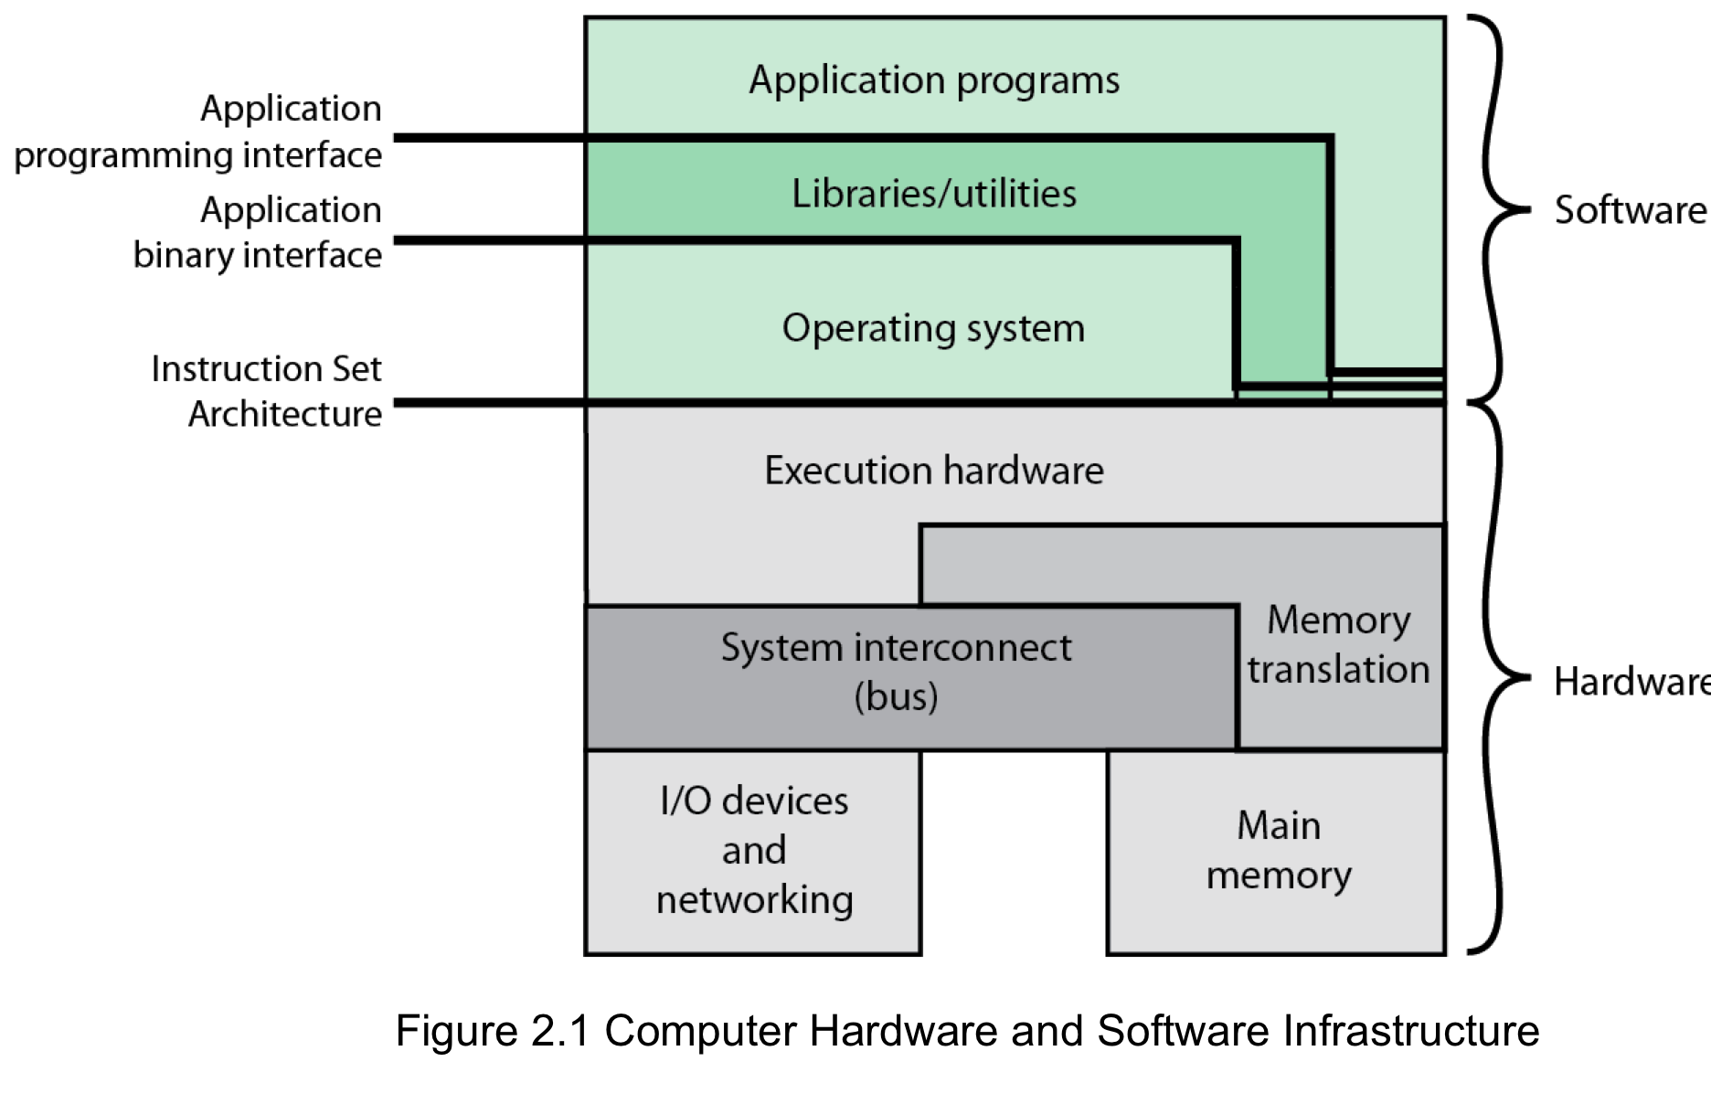
Computer Hardware and Software Infrastructure

Slide 7
Quiz
User’s applications use the system resources to complete their operations by the services of
A. clicking the mouse
B. Keyboard command
C. System call
D. Graphical user interface
C. System call

Slide 8
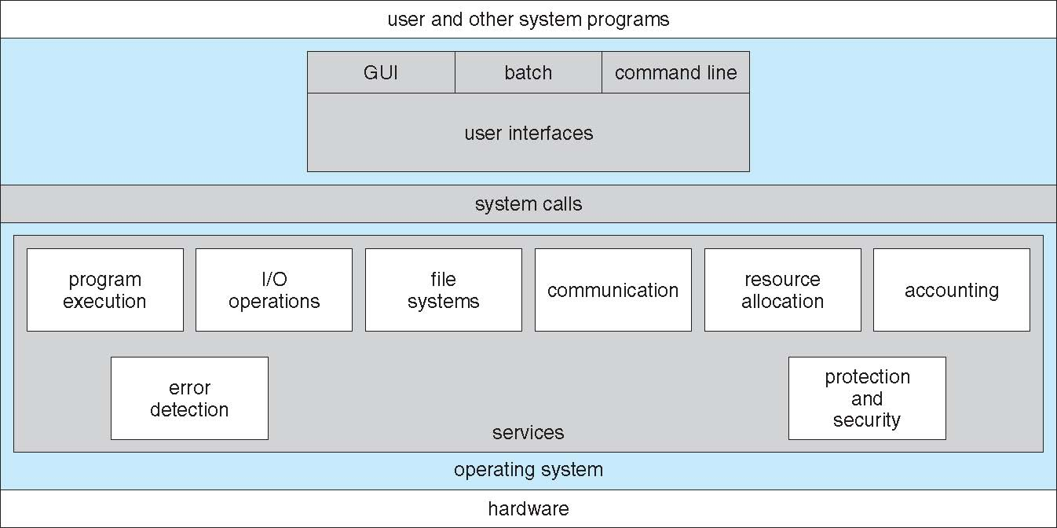
A View of Operating System Services

Slide 9
System Calls
System Calls
  OS provides programming interface to services
  It is how a program requests a service from an OS’s kernel
  May include hardware-related services (for example, accessing a hard disk drive), creation and execution of new processes, and communication with integral kernel services such as process scheduling
Application Programming Interface (API)
  High-level - usually used by programs
  Rather than direct use of system calls
  Usually less detailed then raw calls

Slide 10
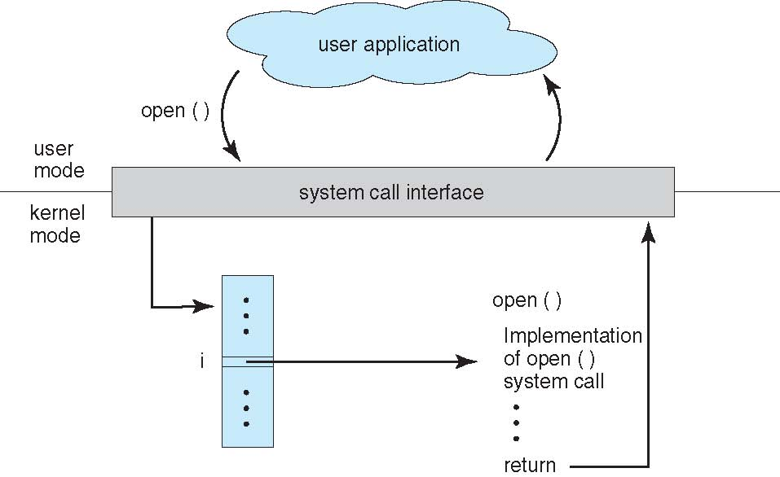
API – System Call – OS Relationship

Slide 11
1.2. Evolution of Operating System
Serial Processing
Simple Batch Systems
Multiprogrammed Batch Systems
Time Sharing Systems
Modern Operating Systems

Slide 12
Serial Processing（串行）
No operating system
Machines run from a console with display lights and toggle switches, input device, and printer.
Two main problems
  Scheduling: waste processing time.
  Setup time: Setup included loading the compiler, source program, saving compiled program, and loading and linking

Slide 13
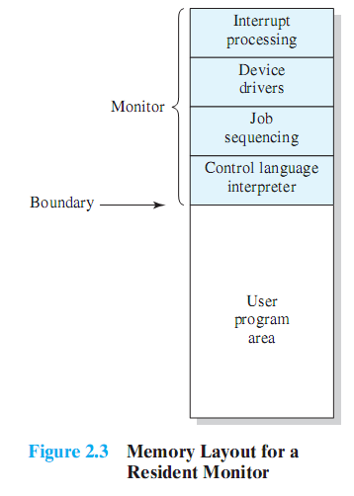
Simple Batch Systems（批处理）
Monitors（监督程序）:Software that controls the running programs
  Resident monitor is in main memory and available for execution
Monitor batches jobs together
Monitor reads in job and gives control
Job returns control to monitor

Slide 14
Quiz
The main disadvantage of batch system is ()
  A. Low degree of automation
  B. Can not concurrent
  C. CPU utilization is low
  D. Lack of interaction
D

Slide 15
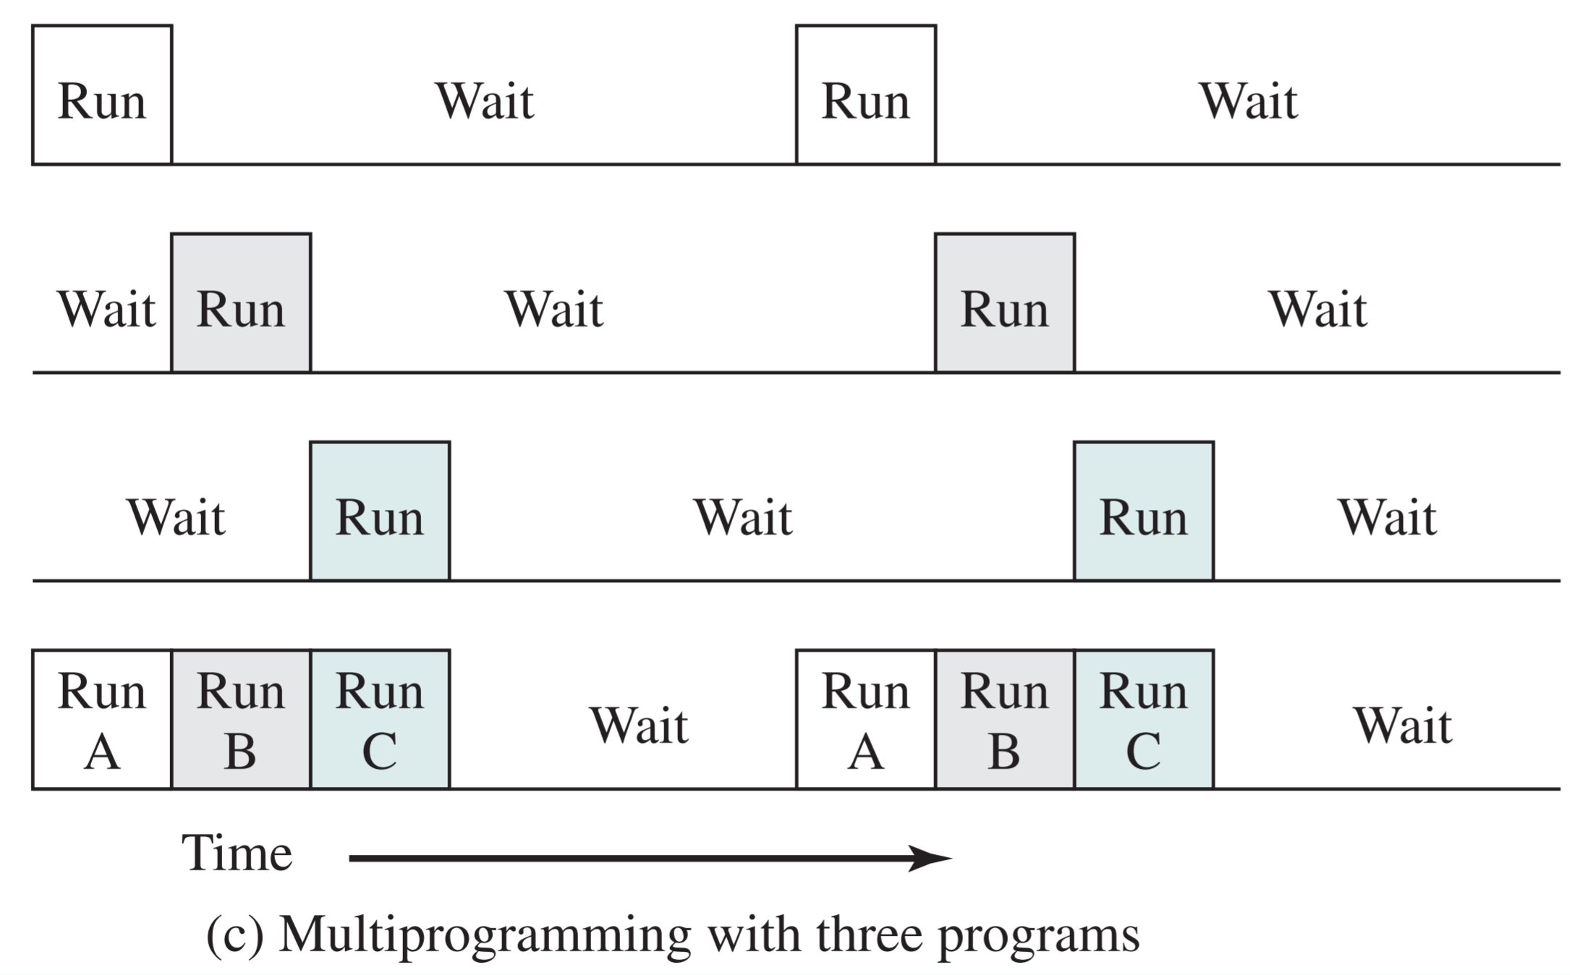
Multiprogramming Batch Programming
There must be enough memory to hold the OS (resident monitor) and one user program
When one job needs to wait for I/O, the processor can switch to the other job, which is likely not waiting for I/O
Program A
Program B
Program C
Combined

Slide 16
Time-Sharing Systems （分时）
Using multiprogramming to handle multiple interactive jobs
Processor’s time is shared among multiple users
 | Batch Multiprogramming | Time Sharing
Principal objective | Maximize processor use | Minimize response time
Source of directives to OS | Job control language Commands provided with the job | Commands entered at the terminal

Slide 17
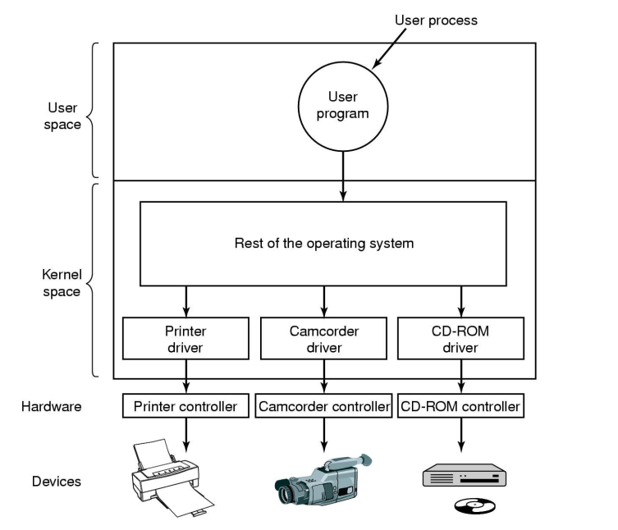
1.3 Kernel Space vs. User Space

Slide 18
1.4 Features of Modern Operating Systems
Demands on operating systems require new ways of organizing the OS
Different approaches and design elements :
Microkernel architecture
Multithreading
Symmetric multiprocessing
Distributed operating systems
Object-oriented design

Slide 19
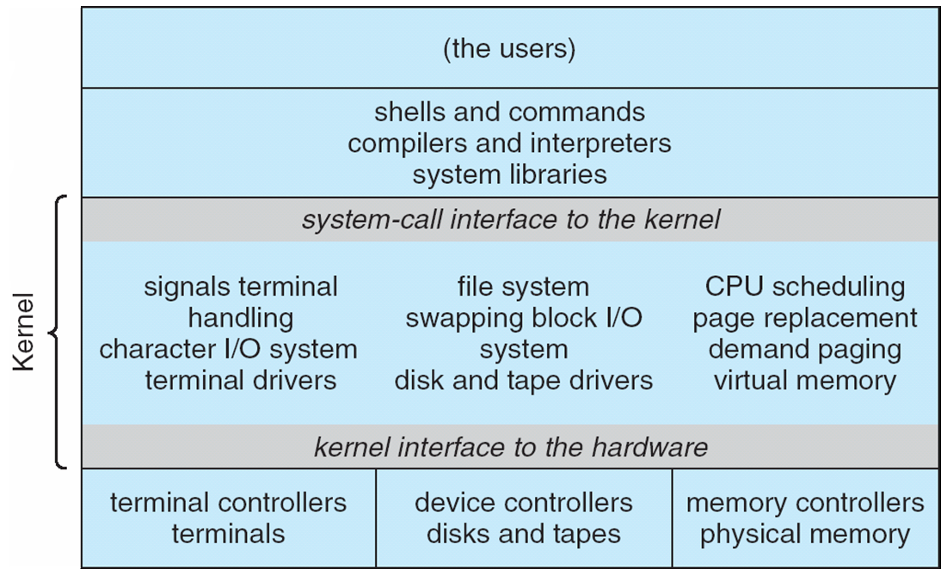
Traditional UNIX System Structure
Beyond simple but not fully layered

Slide 20
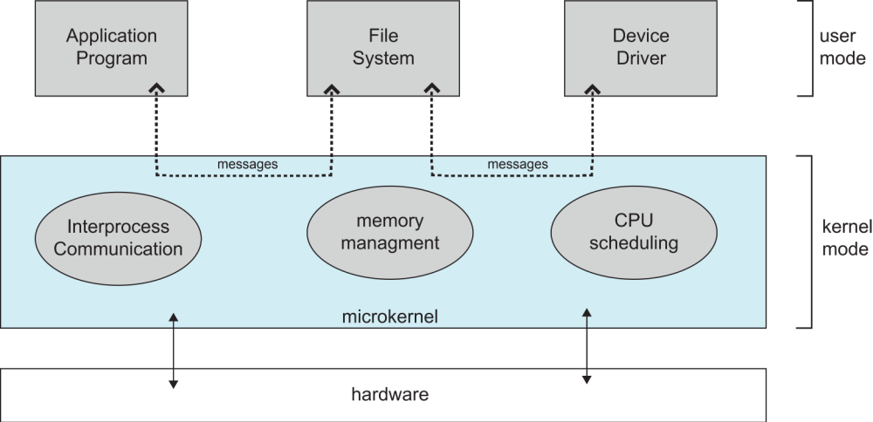
Microkernel System Structure
Communication takes place between user modules using message passing
message passing

Slide 21
Outline
2. Process and threads
  2.1 Process descriptions
  2.2 Process Control Block
  2.3 Five-state transition
  2.4 Process switching
  2.5 Threads
  2.6 Type of Threads
  2.7 Short-term scheduling
  2.8 Approach of thread scheduling

Slide 22
2.1 Process Definitions
Definitions
  A program in execution.
  An instance of a program running on a computer.
  The entity that can be assigned to and executed on a processor.
  A unit of activity characterized by a single sequential thread of execution, a current state, and an associated set of system resources.

Slide 23
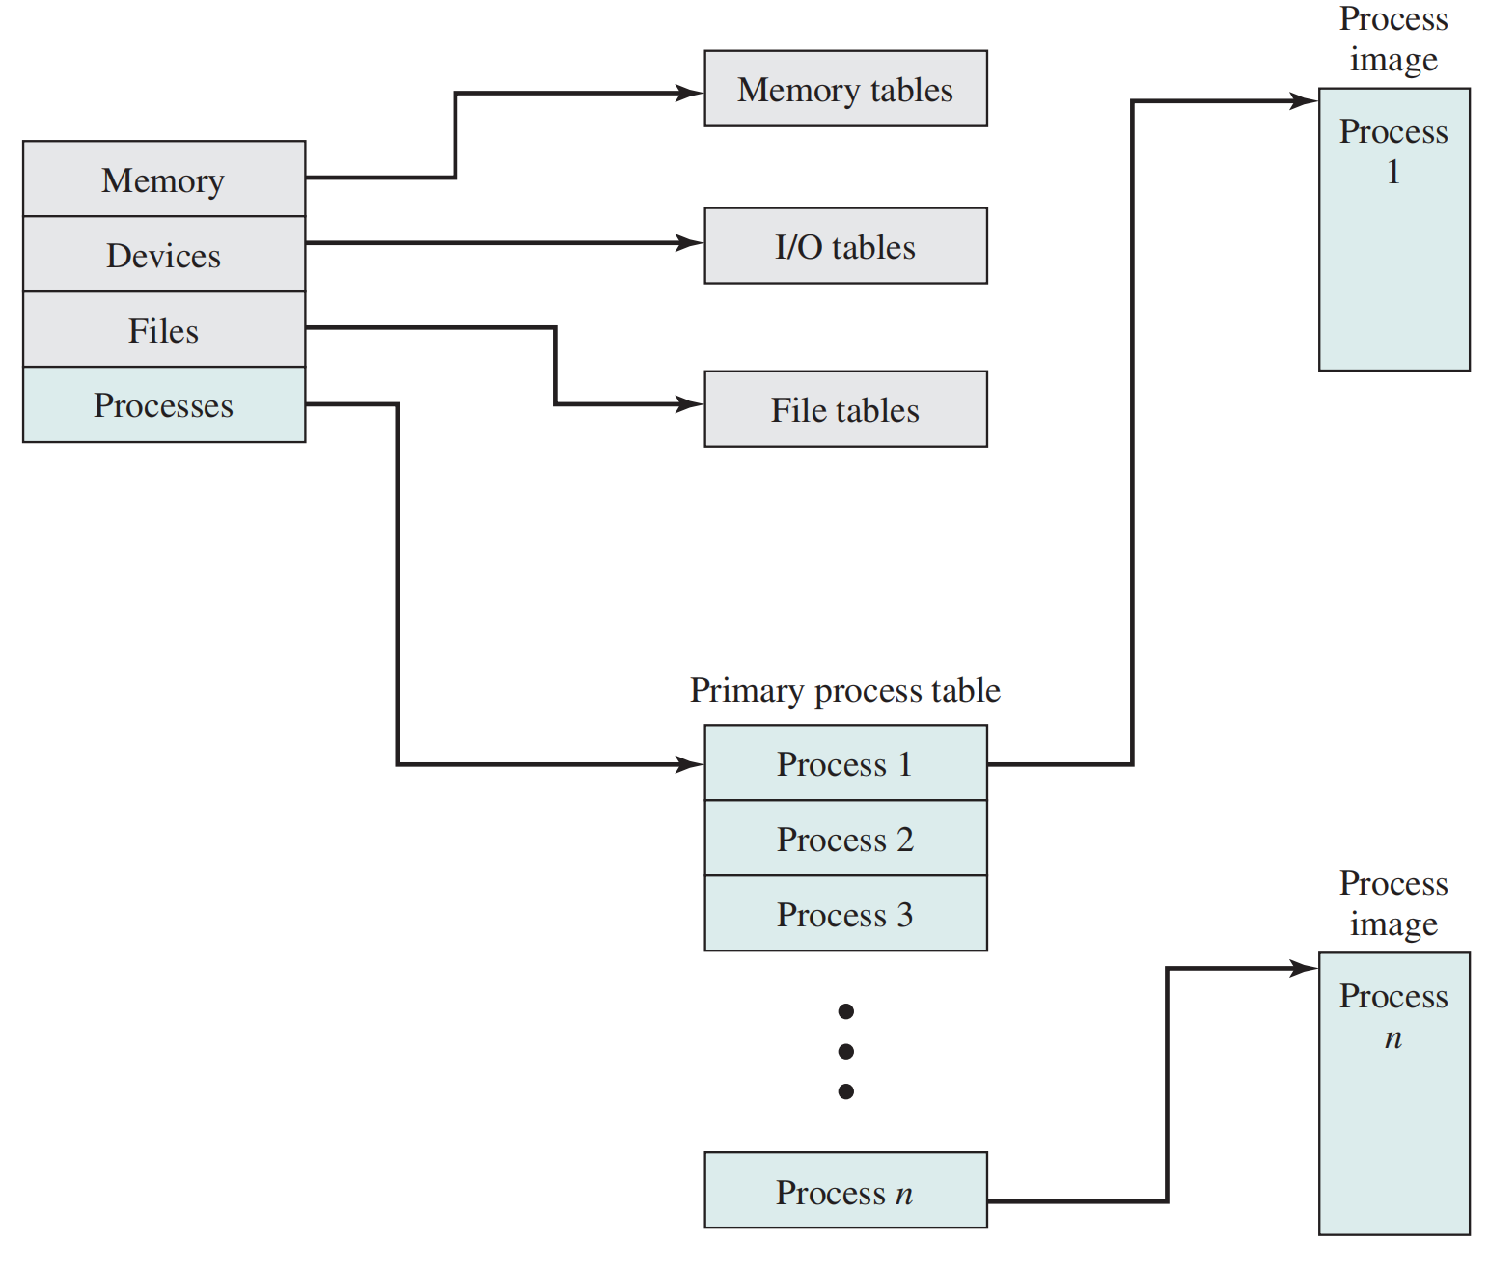
OS Control Structures
  Process table
  Must be maintained to manage processes
  There must be some reference to memory, I/O, and files, directly or indirectly
  The tables themselves must be accessible by the OS and therefore are subject to memory management

Slide 24
Process Image
What is the physical manifestation (物理表示) of a process?
  A process must include a program or set of programs to be executed
  A process will consist of at least sufficient memory to hold the programs and data of that process
  The execution of a program typically involves a stack that is used to keep track of procedure calls and parameter passing between procedures
  Each process has associated with it a number of attributes that are used by the OS for process control
  The collection of program, data, stack, and attributes is referred to as the process image
  Process image location will depend on the memory management scheme

Slide 25
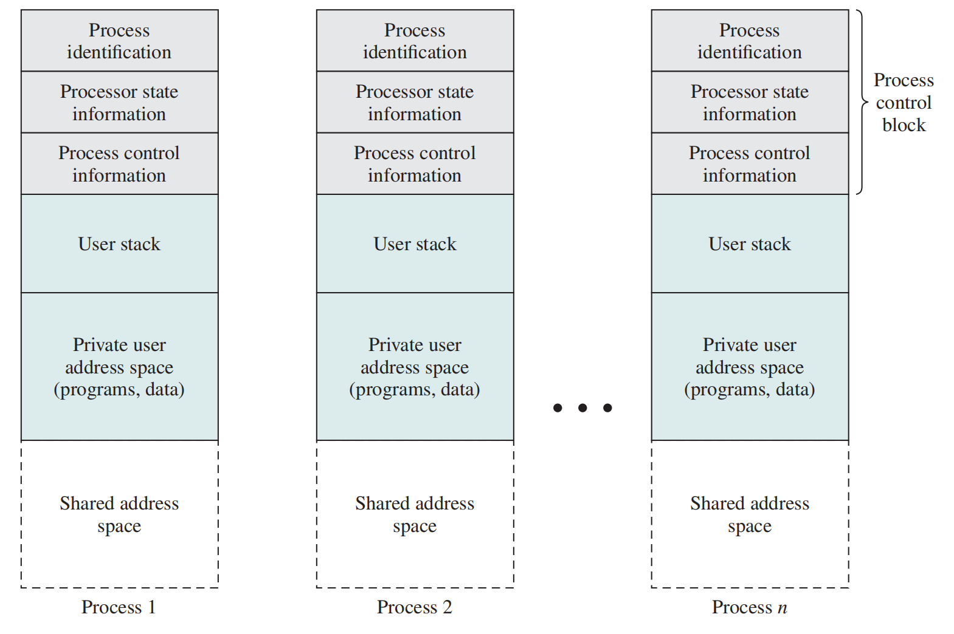
Typical Elements of a Process Image

Slide 26
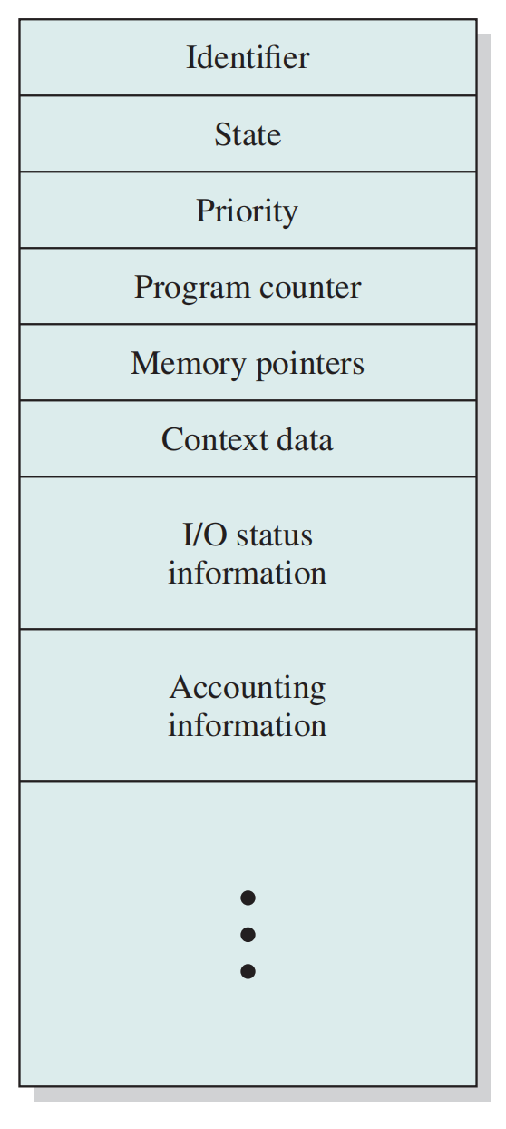
Process Control Block
Contains the process elements
Created and managed by the operating system
Functions:
  It is possible to interrupt a running process and later resume execution as if the interruption had not occurred
  Key tool that allows support for multiple processes

Slide 27
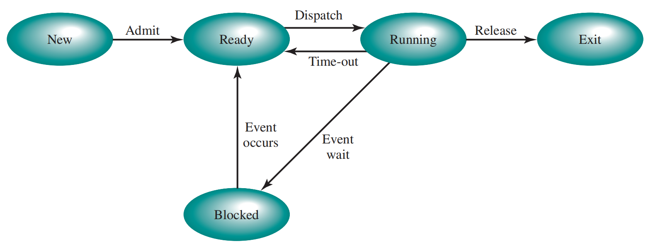
2.3Five-State Process Model

Slide 28
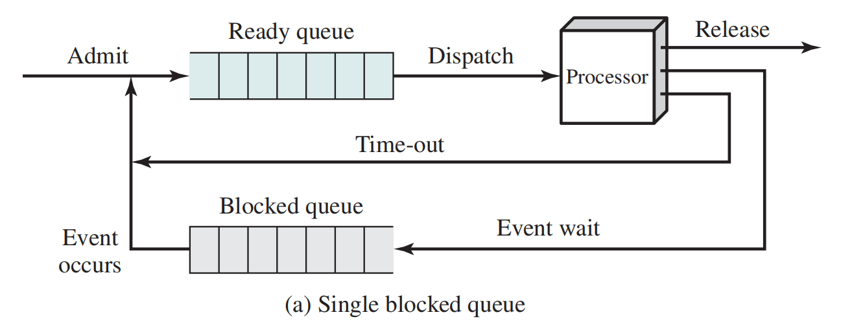
Using Two Queues

Slide 29
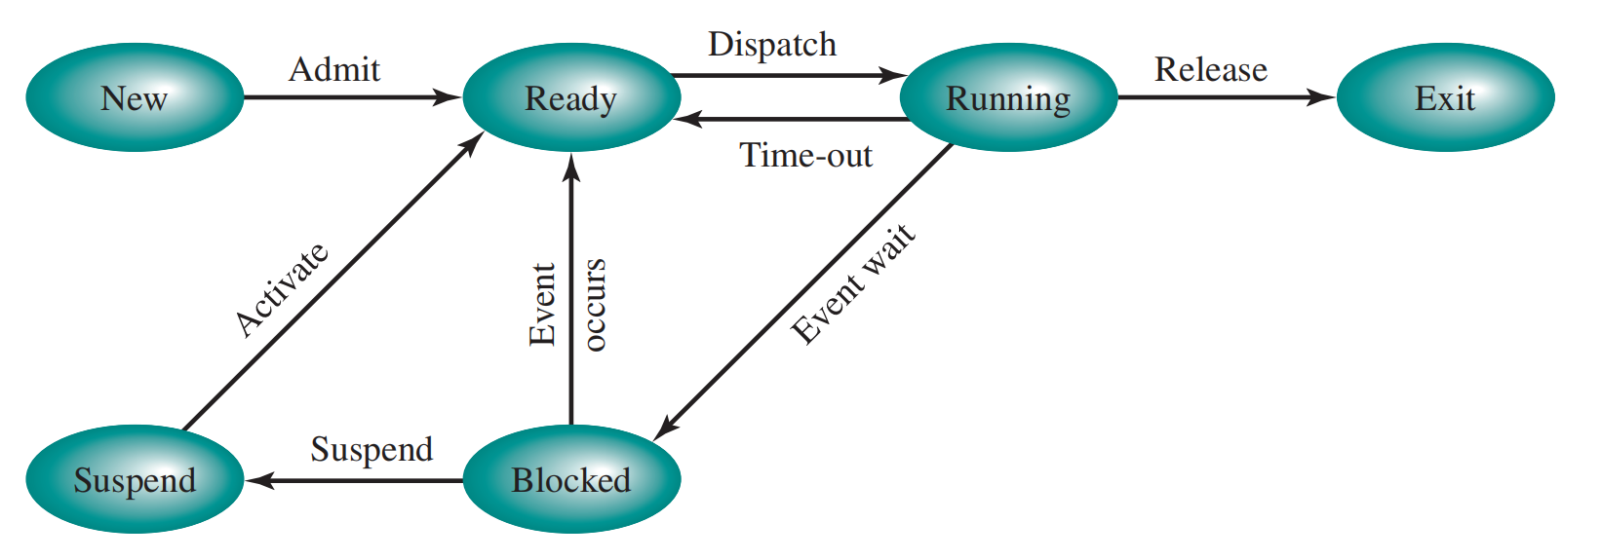
One Suspend State
Notes:
按照刚才描述的交换，必须将另一个状态添加到我们的进程行为模型中（图 3.9a）：挂起 状态。
当主内存中的所有进程都处于 Blocked 状态时，
OS 可以通过将一个进程置于 Suspend 状态并将其传输到磁盘来暂停该进程。然后，可以使用主内存中释放的空间来引入另一个进程。
当 OS 执行了换出作时，它有两个选项来选择要引入主内存的进程：
它可以允许新创建的进程，也可以引入以前暂停的进程。
看起来，首选应该是引入以前暂停的进程，以便为其提供服务，而不是增加系统上的总负载。
但这种推理方式带来了困难。所有已暂停的进程在暂停时都处于 Blocked 状态。显然，将阻塞的进程带回主内存没有任何好处，因为它确实是 仍然没有准备好执行。但是，请注意，每个处于 Suspend 状态的进程最初都是在特定事件上被阻止的。当该事件发生时，该进程不会被阻止，并且可能可供执行。

Slide 30
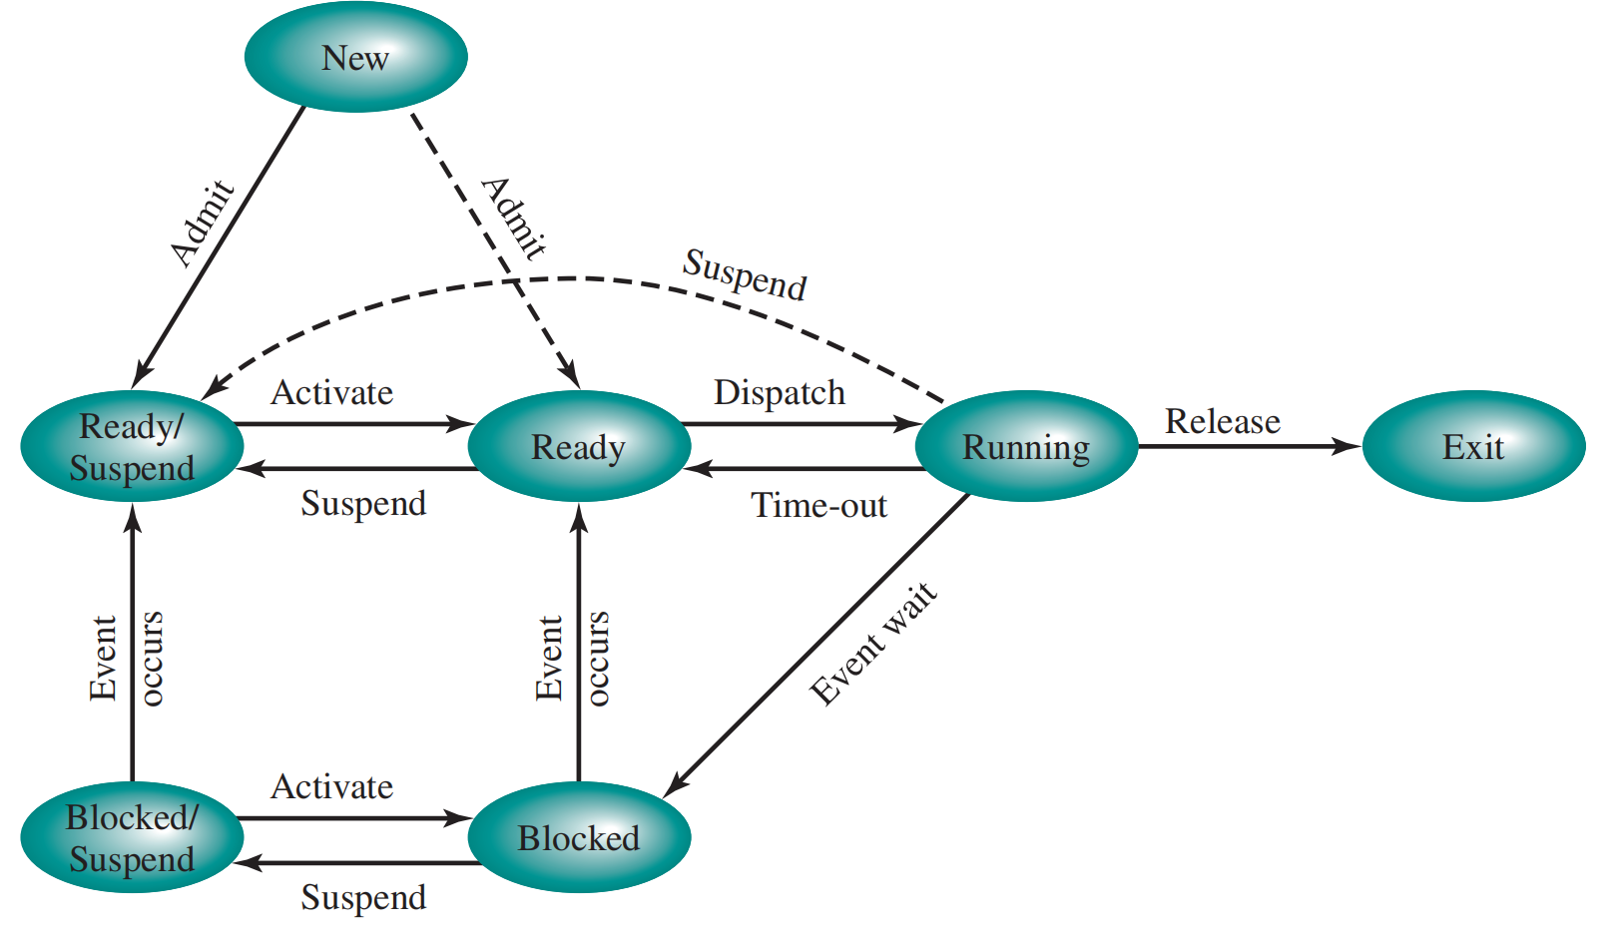
Two Suspend States两种挂起状态

Slide 31

2.4 Process Switching
User mode
Kernel mode
User mode

Slide 32
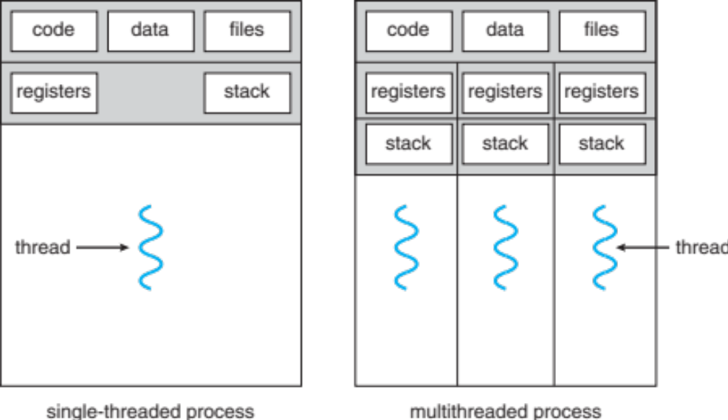
2.5 Processes and Threads
The unit of dispatching is referred to as a thread or lightweight process
The unit of resource ownership is referred to as a process or task
Multithreading: the ability of an OS to support multiple, concurrent paths of execution (多个并发执行路径) within a single process

Slide 33
2.6 Types of Threads
User Level Thread (ULT)
Kernel level Thread (KLT)
Combined Approaches

Slide 34
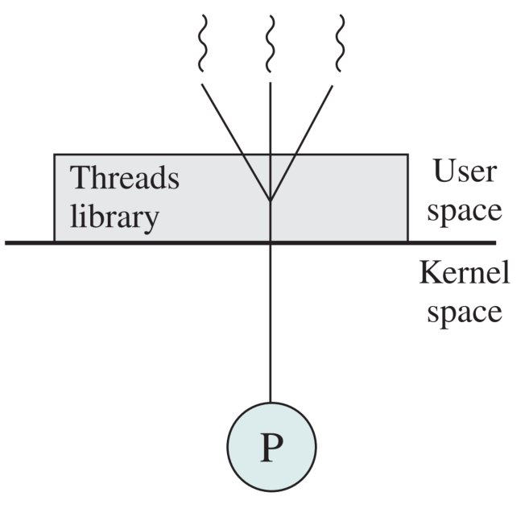
User-Level Threads (ULTs)
All thread management is done by the application
The kernel is not aware of the existence of threads
Thread library provides programmer with API for creating and managing threads
  POSIX Pthreads
  Win32 threads
  Java threads

Slide 35
Advantages of ULTs
Thread switching does not require kernel mode privileges
  all of the thread management data structures are within the user address space of a single process.
  saves the overhead of two mode switches (user to kernel; kernel back to user).
Scheduling can be application specific
  The scheduling algorithm can be tailored to the application without disturbing the underlying OS scheduler.
ULTs can run on any OS
  No changes are required to the underlying kernel to support ULTs. The threads library is a set of application-level functions shared by all applications.

Slide 36
Disadvantages of ULTs
when a ULT executes a system call, not only is that thread blocked, but all of the threads within the process are blocked (Case 1)
In a pure ULT strategy, a multithreaded application cannot take advantage of multiprocessing

Slide 37
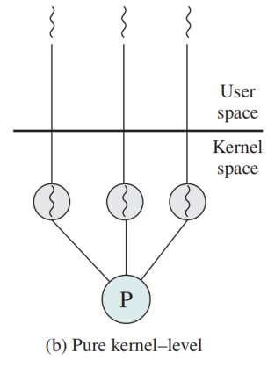
Kernel-Level Threads (KLTs)
Thread management is done by the kernel
  no thread management is done by the application
  The kernel maintains context information for the process as a whole and for individual threads within the process.
  Scheduling by the kernel is done on a thread basis.
Examples – virtually all general purpose OS
  Windows
  Solaris
  Linux
  Tru64 UNIX
  Mac OS X
API

Slide 38
Advantages and Disadvantages of KLTs
Adv.
  The kernel can simultaneously schedule multiple threads from the same process on multiple processors
  If one thread in a process is blocked, the kernel can schedule another thread of the same process
  Kernel routines (内核例程) can be multithreaded
Disadv.
  The transfer of control from one thread to another within the same process requires a mode switch to the kernel

Slide 39
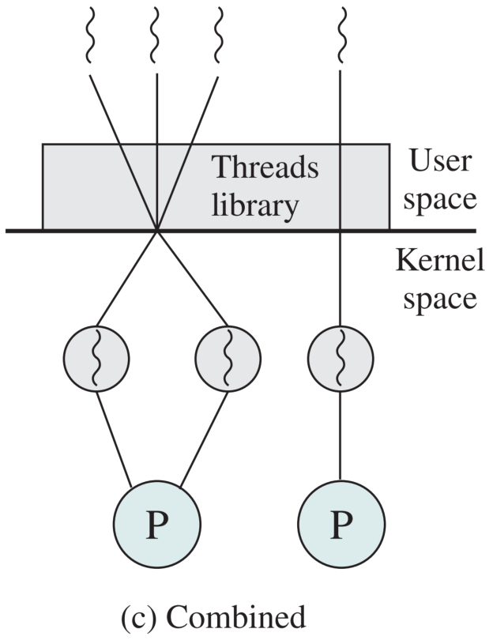
Combined Approaches
Thread creation is done in the user space
Bulk of scheduling and synchronization of threads is by the within an application
The multiple ULTs from a single application are mapped onto some (smaller or equal) number of KLTs.
The programmer may adjust the number of KLTs for a particular application and processor to achieve the best overall results.

Slide 40
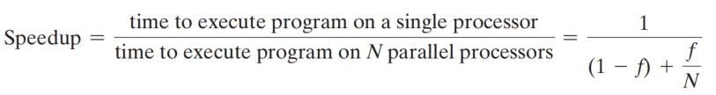
2.7 Multicore / Multithread
  The potential performance benefits of a multicore organization depend on the ability to effectively exploit the parallel resources available to the application.
  A single application running on a multicore system
Amdahl’s Law (阿姆达尔定律)
1-f：a fraction of the serial execution time
f : a fraction of the parallelizable execution time with no scheduling overhead

Slide 41
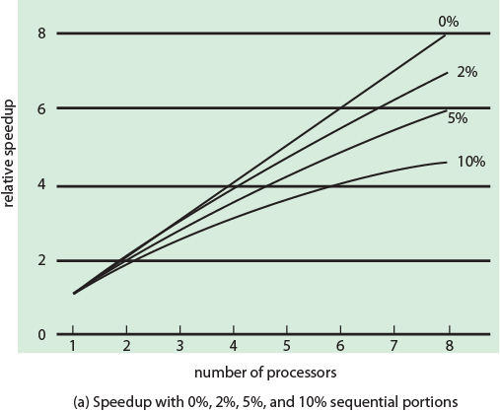
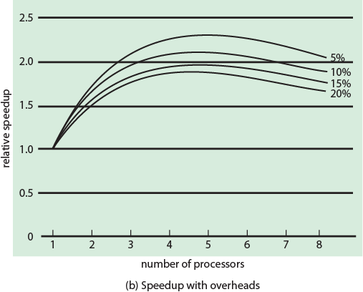
Performance Effect of Multiple Cores
Figure 4.7 (a)
Figure 4.7 (b)

Slide 42
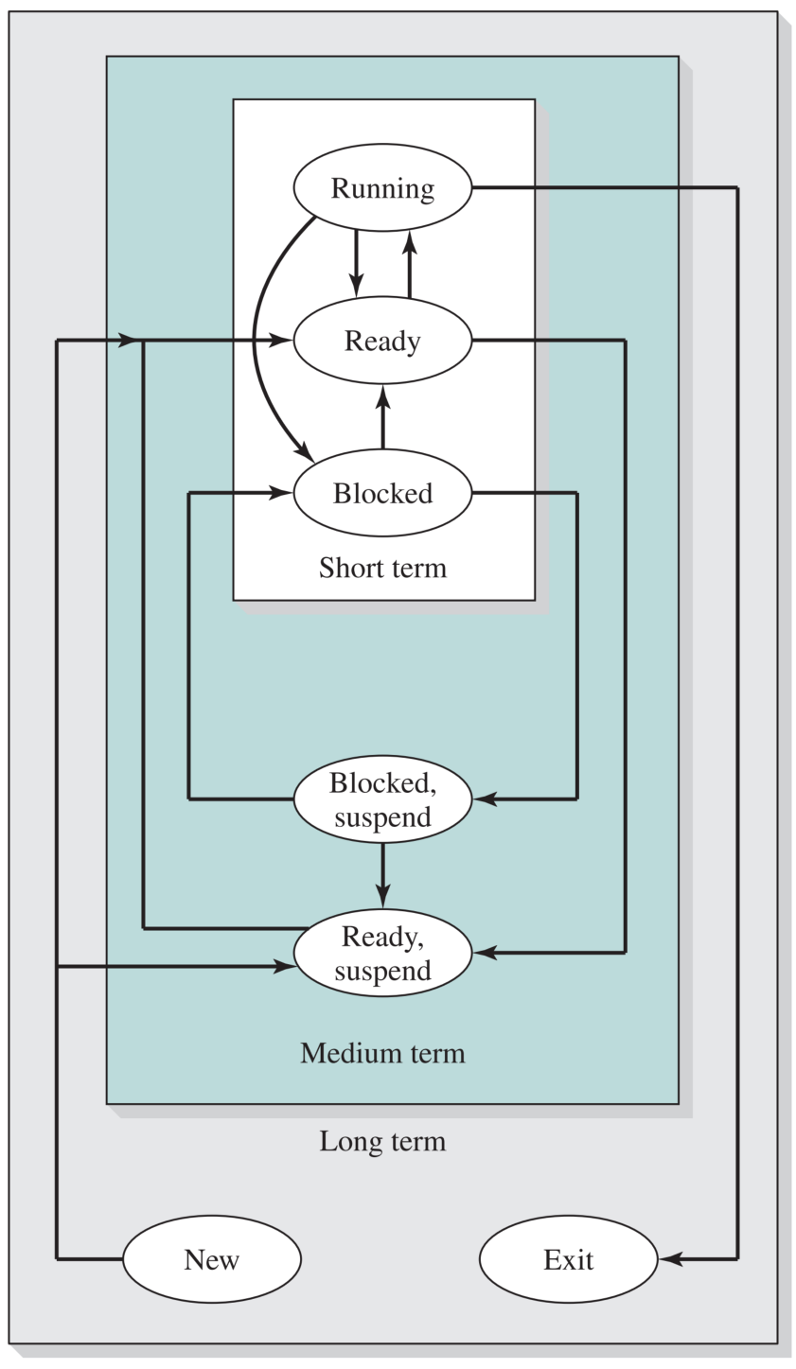
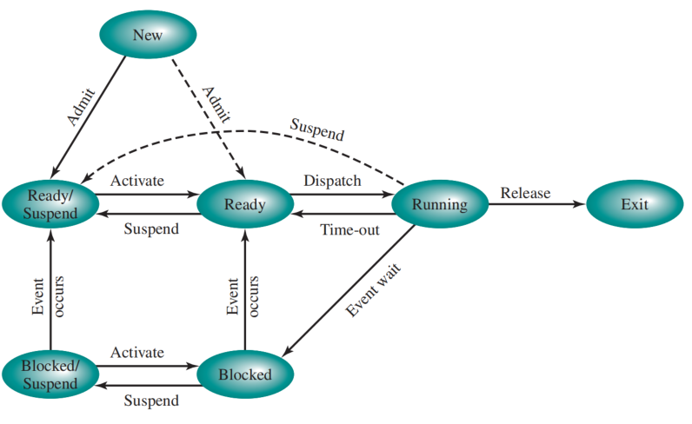
Nesting of Scheduling Functions

Slide 43
2.8 Short Term Scheduling Criteria
User-oriented
  relate to the behavior of the system as perceived （感知）by the individual user or process (such as response time in an interactive system)
  important on virtually all systems
System-oriented
  focus in on effective and efficient utilization of the processor (rate at which processes are completed)
  generally of minor importance on single-user systems
Performance-related (examples: response time, throughput)
  quantitative
  easily measured
Non-performance related (examples: predictability, Fairness)
  Qualitative (定性的)
  hard to measure

Slide 44
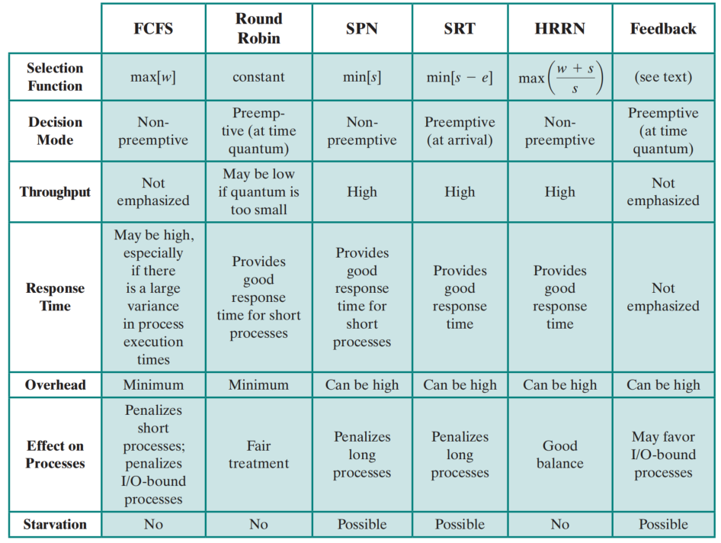
Alternative Scheduling Policies

Slide 45
Consider the following set of processes are to be executed in a uniprocessor system.
Assume the overhead of context switching is one time unit. For each of the following scheduling methods (Note: Assume that once the next process is selected, a newly arriving process during the 1-unit context switch will not change that selection):
(1) First Come First Serviced - FCFS; (2) Shortest Process Next - SPN; (3) Shortest Remaining Time next – SRT; (4) Round Robin - RR with q=3; answer the following questions:
Draw a timing chart to illustrate the execution sequence,
Calculate the average turnaround time.
Process Name | Arrival Time | Service Time
A | 0 | 4
B | 1 | 8
C | 3 | 2
D | 10 | 3
E | 14 | 5

Slide 46
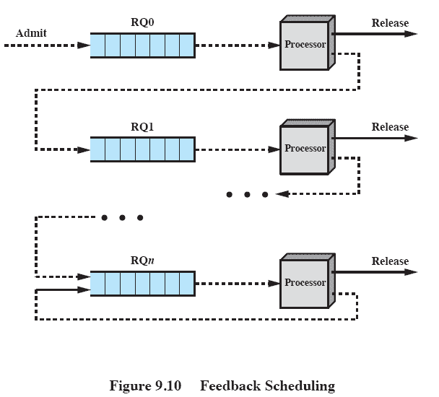
Feedback Scheduling
If we have no indication of the relative length of various processes, then none of SPN, SRT, and HRRN can be used
FB: When a process first enters the system, it is placed in RQ0. After its first preemption, when it returns to the Ready state, it is placed in RQ1.
  a preference for shorter jobs
  focus on the time spent in execution so far

Slide 47
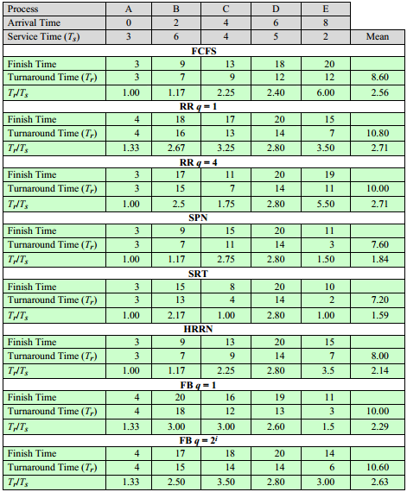
Comparison of Scheduling Policies
T_r/T_s ：Normalized turnaround time

Slide 48
Approaches to Thread Scheduling
Four approaches for multiprocessor thread scheduling and processor assignment are:
  Static Scheduling
    Load Sharing
      processes are not assigned to a particular processor
      When idle, each processor selects a thread from the global threads queue
    Gang Scheduling
      a set of related threads scheduled to run on a set of processors at the same time, on a one-to-one basis
    Dedicated （专用） Processor Assignment
      Each program, for the duration of its execution, is allocated a number of processors equal to the number of threads in the program
  Dynamic Scheduling
    the number of threads in a process can be altered during the course of execution

Slide 49
2.9 Real-time scheduling
Deadline scheduling
  Ready time
    time task becomes ready for execution
  Starting deadline
    time task must begin
  Completion deadline
    time task must be completed
  Processing time
    time required to execute the task to completion
Scheduling of Periodic Real-Time Tasks with Completion Deadlines
Scheduling of Aperiodic Real-Time Tasks with Starting Deadlines

Slide 50
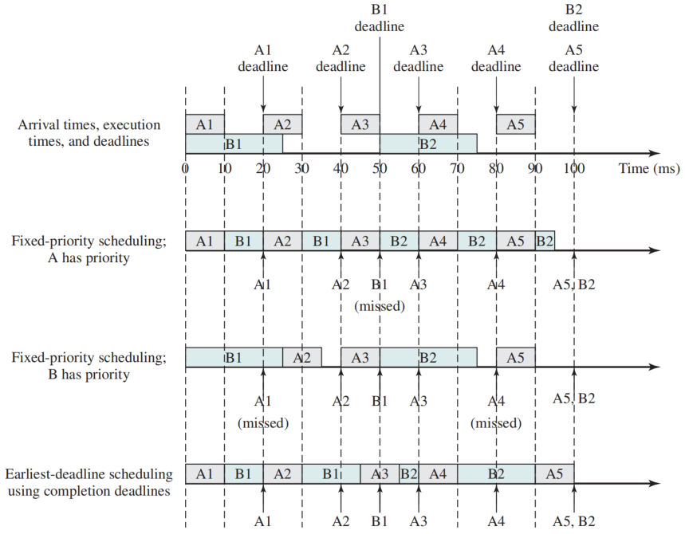
Scheduling of Periodic Real-Time Tasks with Completion Deadlines

Slide 51
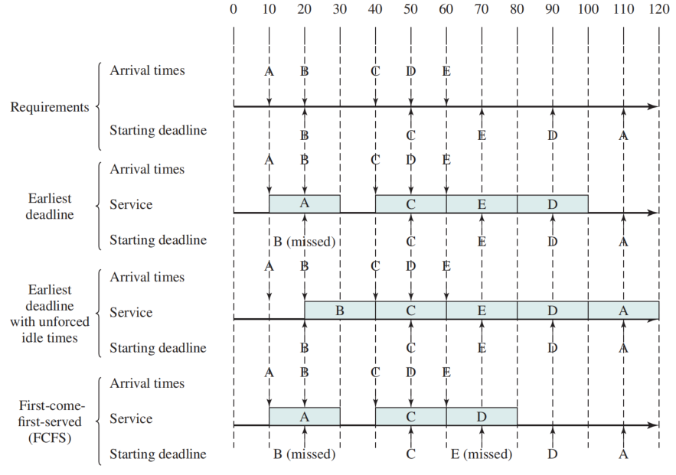
Scheduling of Aperiodic Real-Time Tasks with Starting Deadlines
Non-Preemption

Slide 52
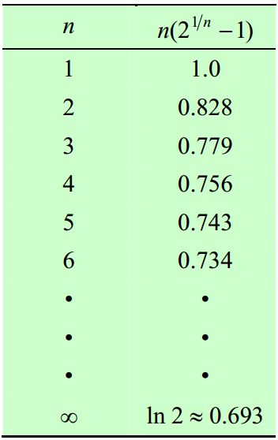
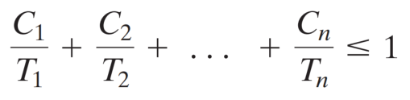

Measure of Periodic Scheduling Algorithm
If a perfect scheduling algorithm can successfully schedule, a bound of number of tasks is
Any particular algorithm, bound may be lower:
C：execution time, T: Cycle period

Slide 53
Quiz
As we all know, the most central concept in any operating system is the process. We can deal with the problem about ( ) easier after importing the concept of process.
  A. exclusive resources
  B. shared resources
  C. executing in order
  D. easy to execute
The concept of a process in an operating system embodies two primary characteristics, one of which is ( )
  A. Resource ownership
  B. Multithreading
  C. Symmetric multiprocessing
  D. None of the above
B
A

Slide 54
Quiz
True or False. Determine whether the following statements are true or false:
A process is the basic unit of resource allocation.
(T)
A thread is the basic unit of CPU scheduling.
(T)

Slide 55
Choice Questions
(1) The fundamental difference between a process and a thread is ( ).
A. A process has an independent address space, and a thread shares the address space within the process
B. A thread is the basic unit of system scheduling, while a process is not
C. A process must contain at least one thread
D. Threads can communicate across processes
A

Slide 56
Choice Questions
(2) A/an ( ) is a system program that acts as an interface between the application programs and the computer hardware.
A. operating system
B. system call
C. library
D. compiler
A

Slide 57
Choice Questions
(3) Which of the following is NOT included in a Process Control Block (PCB)?
A. Process identification
B. Processor state information
C. Process control information
D. User stack
D

Slide 58
True / False Questions
Multiprogramming technology allows multiple programs to run simultaneously, but one CPU can only execute one program at a time. ( )
T

Slide 59
In operating systems, process state models are used to describe the lifecycle of a process and the transitions between different states.
(1) Draw the five-state process model. Your diagram must clearly show and label all states and all possible transitions between them.
(2) Draw the seven-state process model with suspend states included. Your diagram must clearly show and label all states and all possible transitions between them.

Slide 61
Outline
3. Concurrency: mutual exclusion and synchronization
  3.1Mutual Exclusion
  3.2Semaphore
  3.3Monitor
  3.4Message passing
  3.5Producer/Consumer Problem
  3.6Reader Writer Problem

Slide 62
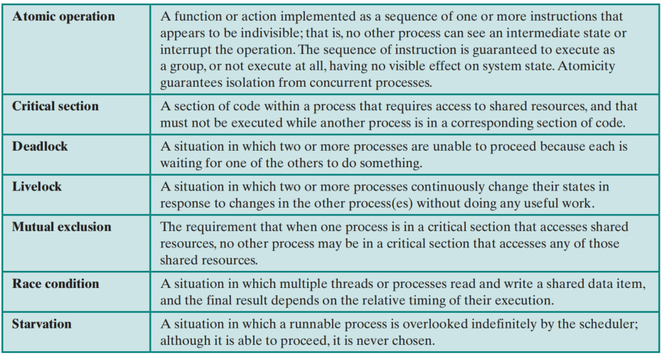
Key Terms Related to Concurrency

Slide 63
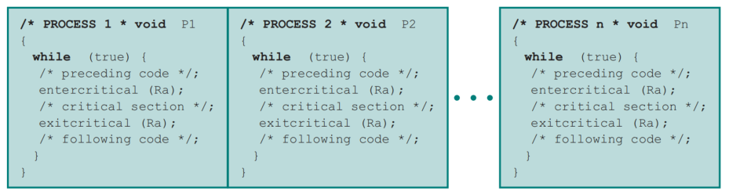
Illustration of Mutual Exclusion

Slide 64
Mutual Exclusion Tools
Software Solution with busy waiting technique:
  Dekker algorithm
  Peterson algorithm
Hardware support
  Interrupt (uniprocesor)
  Machine instruction (MPS)
Supported by OS or enforced by Language compilers without busy waiting
  Semaphore
  Monitor
  message

Slide 65
3.2 Semaphore
A variable that has an integer value upon which only three operations are defined:
  May be initialized to a nonnegative integer value
  The semWait operation decrements the value
  The semSignal operation increments the value
Limitation
  There is no way to know before a process decrements a semaphore whether it will block or not
  There is no way to know which process will continue immediately on a uniprocessor system when two processes are running concurrently
  You don’t know whether another process is waiting so the number of unblocked processes may be zero or one

Slide 66
Examples
The peak number of cars arriving at a shopping mall is 150 per day, but its parking lot can accommodate up to 100 cars at any time. When the number of parked cars is less than 100, other cars can enter immediately, otherwise let the car queue. If the car is regarded as a process, then the car arriving at the mall is a concurrent problem. Give a program fragment (写一段程序) to describe the executions of the cars correctly concurrently with semaphore mechanism.
Semaphore park_lot = 100
Void car(){
While (true){
  semWait(park_lot)；
  enter_lot()；
  Parking()；
  Out_lot()；
  semSignal(park_lot)；
}

Slide 67
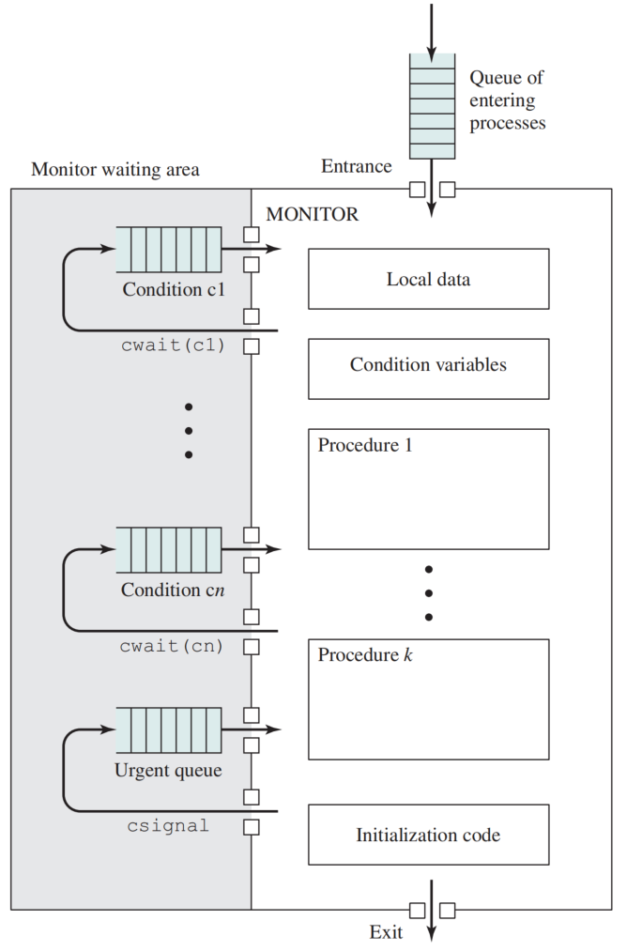
3.3 Monitor
Local data variables: are accessible only by the monitor’s procedures and not by any external procedure.
Procedures: Process enters monitor by calling one of monitor’s procedures
Mutual exclusion ：Only one process may be executing in the monitor and have access to the local data variables at a time. Others are blocked.
Structure of a Monitor

Slide 68
Synchronization
Condition variables： contained within the monitor and accessible only within the monitor
a special data type in monitor，are operated on by two functions:
  cwait(c): block the executing process on condition c; the monitor can be used be the other processes.
  csignal(c): resume one of process blocked by condition cwait(c); if there is no such process, do nothing and signal is lost.
Figure 5.15 Structure of a Monitor

Slide 69
Message Passing
Motivation——when processes interact with one another, two fundamental requirements must be satisfied:
  Synchronization: Processes need to be synchronized to enforce mutual exclusion；
  Communication: cooperating processes may need to exchange information；
The actual function is normally provided in the form of a pair of primitives (原语):
  send (destination, message)
  receive (source, message)

Slide 70
Producer/Consumer Problem
Situation:
  one or more producers are generating data and placing these in a buffer
  a single consumer is taking items out of the buffer one at time
  only one producer or consumer may access the buffer at any one time
Problem:
  Mutual exclusion-one process visit the buffer
  Synchronization- producer can’t add data into full buffer
  Synchronization- consumer can’t remove data from an empty buffer

Slide 71
In a smart railway monitoring system, two concurrent threads share an alarm queue of size N = 256 in memory. A detector thread continuously monitors track conditions and inserts detected abnormal events into the queue. A dispatcher thread removes events from the queue and sends alert messages to the control center. Use semaphores to synchronize the two threads and ensure the following:
The detector thread waits if the queue is full (i.e., 256 events are already stored).
The dispatcher thread waits if the queue is empty (i.e., no event is available to send).
At most one thread can access the shared queue at any time.
Answer the following questions:
(1) Declare the semaphore variables and queue size constant needed to solve this synchronization problem.
(2) Write the logic of the detector thread using appropriate semaphore operations.
(3) Write the logic of the dispatcher thread using appropriate semaphore operations.

Slide 72
semaphore empty = 256;
semaphore full = 0;
semaphore mutex = 1;
DetectorThread() {
while (true) {
event = detect_abnormal_event();
P(empty);
P(mutex);
insert(queue, event);
V(mutex);
V(full);
}
}
DispatcherThread() {
while (true) {
P(full);
P(mutex);
event = remove(queue);
V(mutex);
V(empty);
send_alert(event);
}
}

Slide 73
Readers/Writers Problem
A data area is shared among many processes
  some processes only read the data area (readers)
  some only write to the data area (writers)
Conditions that must be satisfied:
  any number of readers may simultaneously read the file
  only one writer at a time may write to the file
  if a writer is writing to the file, no reader may read it

Slide 74
Outline (cont.)
4. Concurrency: Deadlock and starvation
  4.1Conditions for Deadlock
  4.2Three approaches dealing with deadlock
  4.3Dining Philosophers Problem

Slide 75
Quiz
Which of the following is NOT a necessary condition for deadlock?
A. Mutual Exclusion
B. Hold and Wait
C. Circular Wait
D. Priority Scheduling
Answer: D. Priority Scheduling

Slide 76
4.1 Conditions for Deadlock
Mutual Exclusion
  only one process may use a resource at a time
Hold and Wait
  a process may hold allocated resources while awaiting assignment of others
No Preemption
  no resource can be forcibly removed from a process holding it
Circular Wait
  a closed chain of processes exists, such that each process holds at least one resource needed by the next process in the chain

Slide 77
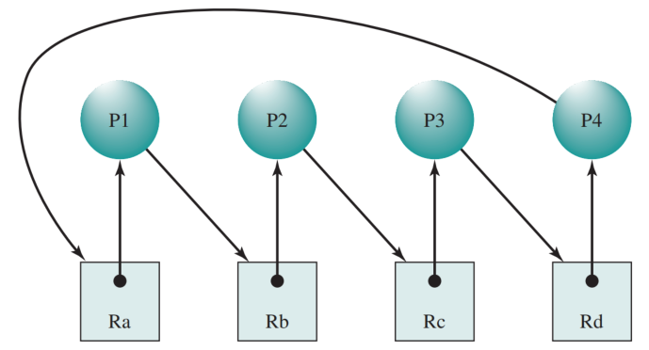
Resource Allocation Graphs
Circular wait. A closed chain of processes exists, such that each process holds at least one resource needed by the next process in the chain
Resource Allocation Graph for Figure 6.1b

Slide 78
4.2 Three Approaches Dealing with Deadlock
Deadlock prevention: Disallow one of the three necessary conditions for deadlock occurrence, or prevent circular wait condition from happening.
Deadlock avoidance: Do not grant a resource request if this allocation might lead to deadlock.
Deadlock detection: Grant resource requests when possible, but periodically check for the presence of deadlock and take action to recover.

Slide 79
Two Approaches to Deadlock Avoidance
Process Initiation Denial
  do not start a process if its demands might lead to deadlock
Resource Allocation Denial (banker algorithm)
  do not grant an incremental resource request to a process if this allocation might lead to deadlock
  State of the system reflects the current allocation of resources to processes
  Safe state is one in which there is at least one sequence of resource allocations to processes that does not result in a deadlock
  Unsafe state is a state that is not safe

Slide 80
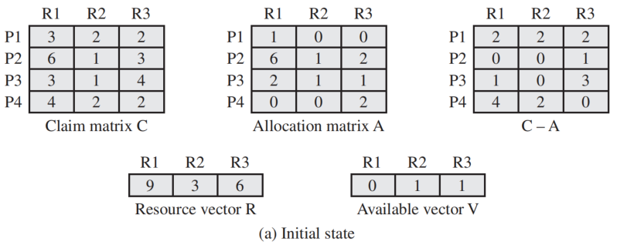
Determination of a Safe State
State of a system consisting of four processes and three resources
Allocations have been made to the four processes
Amount of existing resources
Resources available after allocation

Slide 81
Determination of a Safe State
State of a system consisting of four processes and three resources
Allocations have been made to the four processes

Slide 82
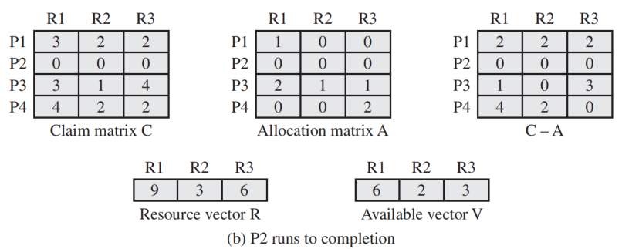
P2 Runs to Completion

Slide 83
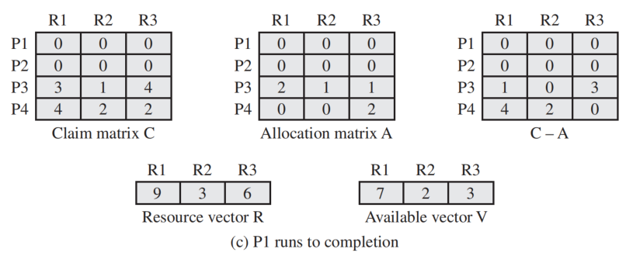
P1 Runs to Completion

Slide 84
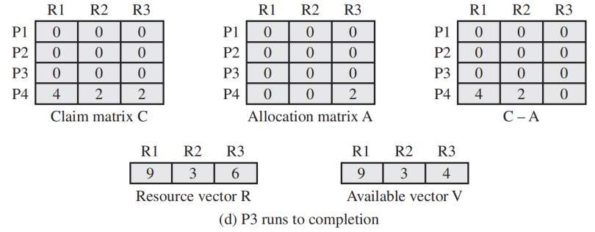
P3 Runs to Completion
Thus, the state defined originally is a safe state.
The sequence is P2, P1,P3,P4

Slide 85
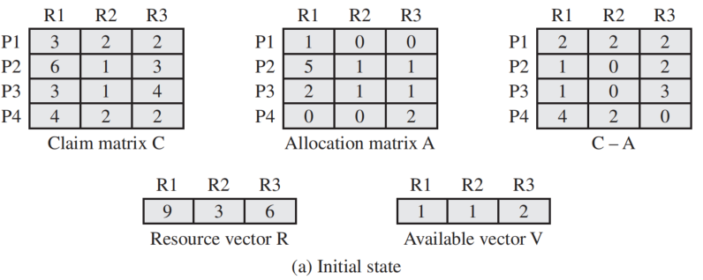
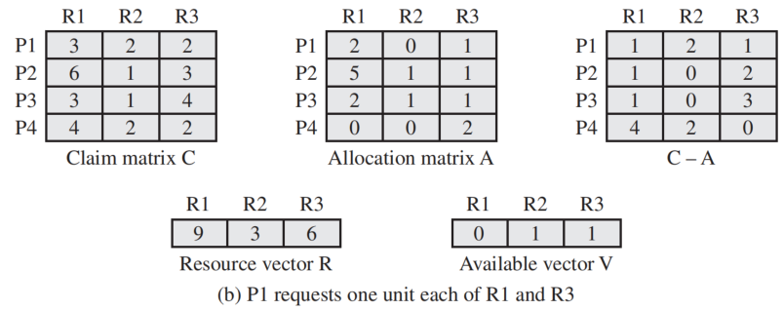
Determination of an Unsafe State

Slide 86
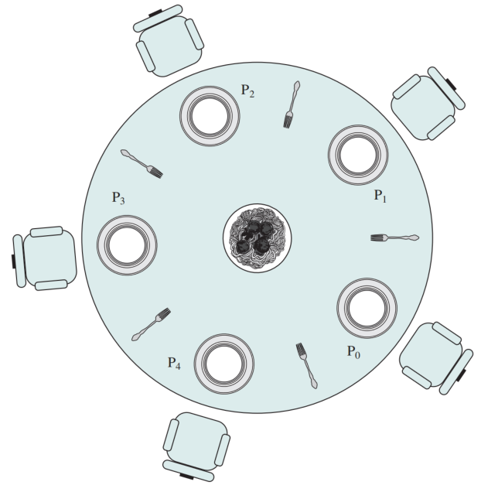
Dining Philosophers Problem
Devise a algorithm that allow the philosophers to eat
  No two philosophers can use the same fork at the same time (mutual exclusion)
  Avoid deadlock and starvation
using the two forks on either side of the plate, takes and eats some spaghetti

Slide 87
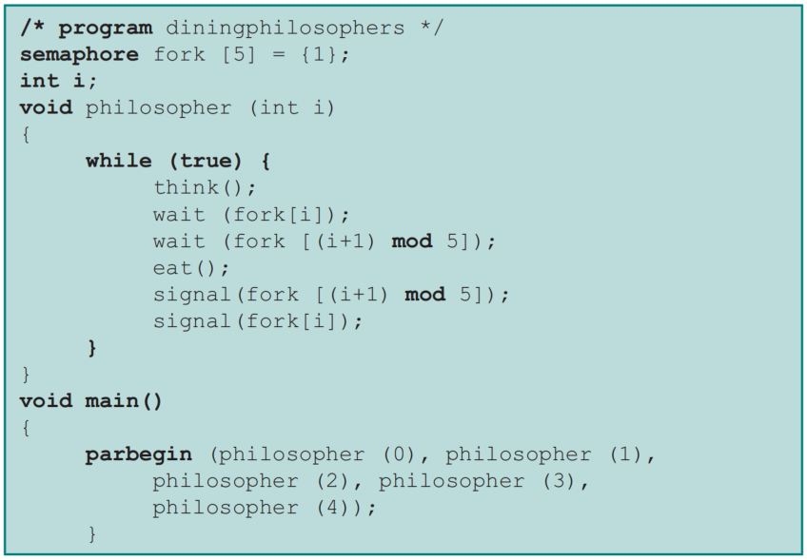
Solution Using Semaphores
Each philosopher first picks up the fork on the left then the fork on the right.

Slide 88
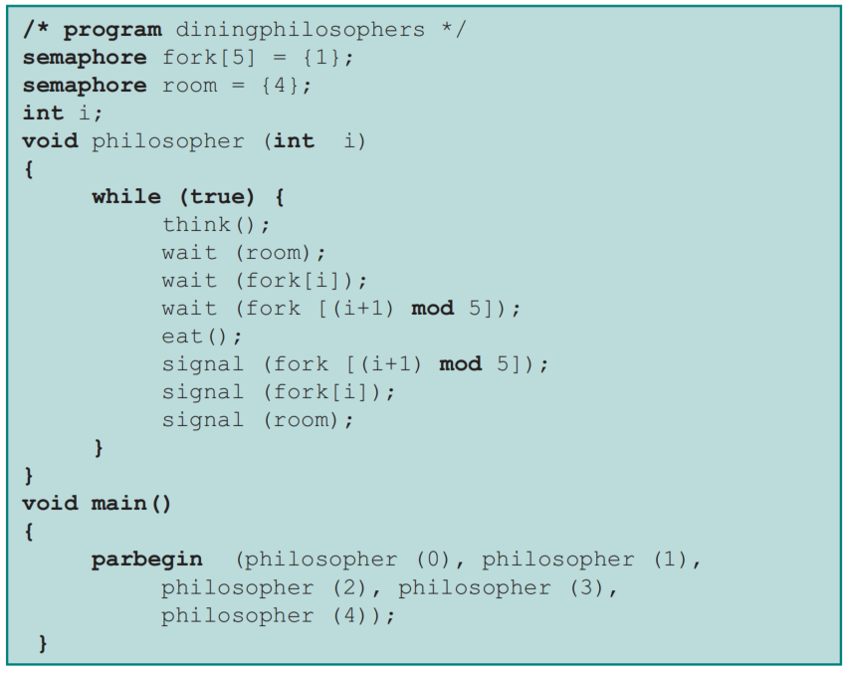
A Second Solution . . .
consider adding an attendant who only allows four philosophers at a time into the dining room.

Slide 89
(4) What problem is the banker's algorithm used to solve？ ( ).
A. Deadlock prevention
B. Deadlock detection
C. Deadlock avoidance
D. Deadlock recovery
C

Slide 90
(5) Which scheduling algorithm assigns fixed time slices to all runnable processes in a cyclic manner?
( )
A. Shortest Job First (SJF)
B. Priority Scheduling
C. Round Robin (RR)
D. Multilevel Feedback Queue
C

Slide 91
True / False Questions
Long-term scheduling is the same as CPU scheduling; it determines which process to execute next.
F

Slide 92
True / False Questions
Medium-term scheduling determines the degree of multiprogramming. ( )
F

Slide 93
True / False Questions
A tightly coupled multiprocessor consists of a set of processors that share a common cache memory and are under the integrated control of one operating system. ( )
F

Slide 94
True / False Questions
In priority inheritance, if a high-priority task is blocked waiting for a resource held by a lower-priority task, the lower-priority task temporarily inherits the higher priority until it releases the resource. ( )
T

